Slide 1
Standards for Mathematical Practice
Ellen Whitesides
Director, Common Core State Standards Projects

Slide 2
Standards for Mathematical Practice
Make sense of problems and persevere in solving them
Reason abstractly and quantitatively
Construct viable arguments and critique the reasoning of others
Model with mathematics
Use appropriate tools strategically
Attend to precision
Look for and make use of structure
Look for and express regularity in repeated reasoning

Slide 3
MP 1: Make sense of problems and persevere in solving them.
Mathematically Proficient Students:
Explain the meaning of the problem to themselves
Look for entry points
Analyze givens, constraints, relationships, goals
Make conjectures about the solution
Plan a solution pathway
Consider analogous problems
Try special cases and similar forms
Monitor and evaluate progress, and change course if necessary
Check their answer to problems using a different method
Continually ask themselves “Does this make sense?”
Gather Information
Make a plan
Continuously evaluate progress
Check results
Question sense of solutions
Anticipate possible solutions
© Institute for Mathematics & Education 2011

Slide 4
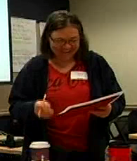
MP 2: Reason abstractly and quantitatively
Decontextualize
Represent as symbols, abstract the situation
Contextualize
Pause as needed to refer back to situation
5
Mathematical Problem
½
P
x x x x
Tucson educator explains SMP #2
Skip to Min 5
© Institute for Mathematics & Education 2011

Slide 5
MP 3: Construct viable arguments and critique the reasoning of others
Use assumptions, definitions, and previous results
Make a conjecture
Build a logical progression of statements to explore the conjecture
Analyze situations by breaking them into cases
Recognize and use counter examples
Distinguish correct logic
Communicate conclusions
Explain flaws
Justify conclusions
Ask clarifying questions
Respond to arguments
© Institute for Mathematics & Education 2011

Slide 6
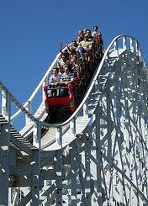
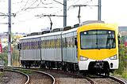
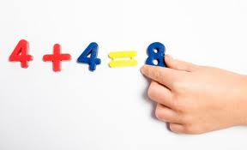
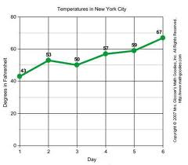
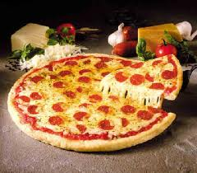
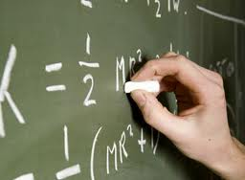
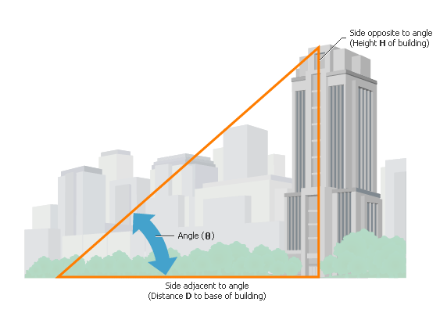
MP 4: Model with mathematics
Problems in everyday life…
…reasoned using mathematical methods
Mathematically proficient students
make assumptions and approximations to simplify a situation, realizing these may need revision later
interpret mathematical results in the context of the situation and reflect on whether they make sense
Images: http://tandrageemaths.wordpress.com, asiabcs.com, ehow.com, judsonmagnet.org, life123.com, teamuptutors.com, enwikipedia.org, glennsasscer.com
© Institute for Mathematics & Education 2011

Slide 7
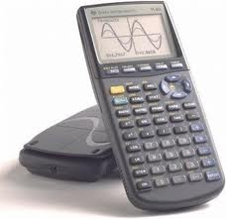
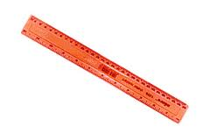
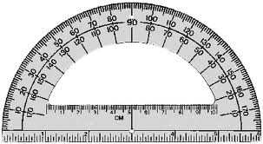
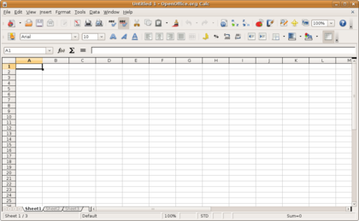
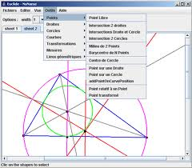
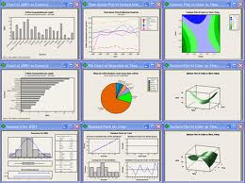
MP 5: Use appropriate tools strategically
Proficient students
are sufficiently familiar with appropriate tools to decide when each tool is helpful, knowing both the benefit and limitations
detect possible errors
identify relevant external mathematical resources, and use them to pose or solve problems
© Institute for Mathematics & Education 2011

Slide 8
MP 6: Attend to precision
Mathematically proficient students
communicate precisely to others
use clear definitions
state the meaning of the symbols they use
specify units of measurement
label the axes to clarify correspondence with problem
calculate accurately and efficiently
express numerical answers with an appropriate degree of precision
Comic: http://forums.xkcd.com/viewtopic.php?f=7&t=66819
© Institute for Mathematics & Education 2011

Slide 9
MP 7: Look for and make use of structure
Mathematically proficient students
look closely to discern a pattern or structure
step back for an overview and shift perspective
see complicated things as single objects, or as composed of several objects
© Institute for Mathematics & Education 2011

Slide 10
MP 8: Look for and express regularity in repeated reasoning
Mathematically proficient students
notice if calculations are repeated and look both for general methods and for shortcuts
maintain oversight of the process while attending to the details, as they work to solve a problem
continually evaluate the reasonableness of their intermediate results
© Institute for Mathematics & Education 2011

Slide 11
Standards for Mathematical Practice
Make sense of problems and persevere in solving them
Reason abstractly and quantitatively
Construct viable arguments and critique the reasoning of others
Model with mathematics
Use appropriate tools strategically
Attend to precision
Look for and make use of structure
Look for and express regularity in repeated reasoning

